Slide 1

Rigorous Reading:
5 Access Points
Doug Fisher
www.fisherandfrey.com

Slide 2


Slide 3
Difficulty v. Complexity
Difficulty
Complexity
A measure of effort required to complete a task.
In assessment, a function of how many people can complete the task correctly.
A measure of the thinking, action, or knowledge that is needed to complete the task.
In assessment, how many different ways can the task be accomplished.

Slide 6

Marc Umile is among a group of people fascinated with pi, a number that has been computed to more than a trillion decimal places. He has recited pi to 15,314 digits.

Slide 7
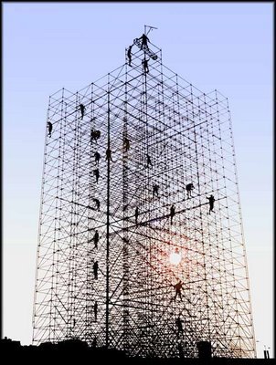
Differentiate according to difficulty, not complexity.

Slide 8
More Complex
Strategic Thinking
Expertise
Low Difficulty
High Complexity
High Difficulty
High Complexity
Easy
Hard
Low Difficulty
Low Complexity
High Difficulty
Low Complexity
Fluency
Stamina
Less Complex

Slide 9

5 Access Points
Purpose and Modeling
Close and Scaffolded Reading
Collaborative Conversations
Wide, Independent Reading
Formative Assessments

Slide 10
5 Access Points
Purpose and Modeling
Close and Scaffolded Reading
Collaborative Conversations
Wide, Independent Reading
Formative Assessments

Slide 11

The established purpose
focuses on student learning, rather than an activity, assignment, or task.

Slide 12
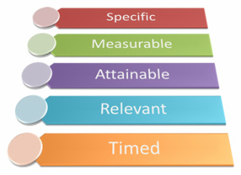

Slide 13
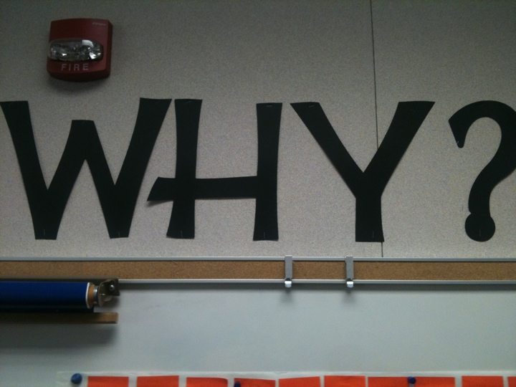

Slide 14

Three Questions
What am I learning today?
Why am I learning this?
How will I know that I have learned it?

Slide 15

Modeling and Demonstrating

Slide 16

Aspects of Modeling
Comprehension • Word Solving
Text Structures • Text Features

Slide 17
Modeling Comprehension
Inference
Summarize
Predict
Clarify
Question
Visualize
Monitor
Synthesize
Evaluate
Connect

Slide 18
Word Solving
Context clues
Word parts (prefix, suffix, root, base, cognates)
Resources (others, Internet, dictionary)

Slide 19
Using Text Structure
Informational Texts
  Problem/Solution, Compare/Contrast, Sequence, Cause/Effect, Description
Narrative Texts
  Story grammar (plot, setting, character)
  Dialogue
  Literary devices

Slide 20
Using Text Features
Headings
Captions
Illustrations
Charts
Graphs
Bold words
Table of contents
Glossary
Index
Tables
Margin notes
Italicized words

Slide 21
5 Access Points
Purpose and Modeling
Close and Scaffolded Reading
Collaborative Conversations
Wide, Independent Reading
Formative Assessments

Slide 22

Reading Volume Still Matters

Slide 23

STUDENT A
20 MINUTES PER DAY
1,800,000 WORDS PER YEAR
SCORES IN THE 90TH PERCENTILE ON STANDARDIZED TESTS

Slide 24

STUDENT B
5 MINUTES PER DAY
282,000 WORDS PER YEAR
SCORES IN THE 50TH PERCENTILE ON STANDARDIZED TESTS

Slide 25

STUDENT C
1 MINUTE PER DAY
8,000 WORDS PER YEAR
SCORES IN THE 10TH PERCENTILE ON STANDARDIZED TESTS

Slide 26
5 Access Points
Purpose and Modeling
Close and Scaffolded Reading
Collaborative Conversations
Wide, Independent Reading
Formative Assessments

Slide 27
Purpose
To identify the essential components of close reading (RL/RI 1) of complex texts
(RL/RI 10) which includes collaborative conversations (S & L 1) and writing from sources (W 1), fostering language development (L 6) and deeper thinking.

Slide 28

10. Read and comprehend complex literary and informational texts independently and proficiently.

Slide 30
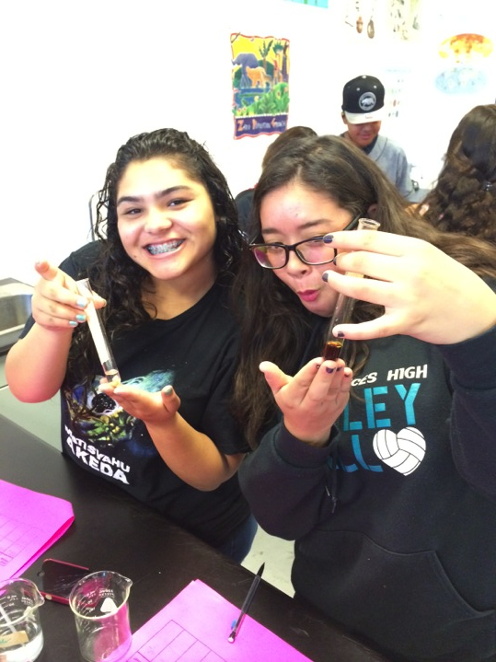

Perceptions are reality

Slide 31

To build strength
More Complex
Less Complex
To build stamina

Slide 32

Simply assigning hard books
will not ensure that students
learn at high levels!

Slide 33

TEACH complex text
don’t just
ASSIGN complex text

Slide 34

1. Read closely to determine what the text says explicitly and to make logical inferences from it; cite specific textual evidence when writing or speaking to support conclusions drawn from the text.

Slide 35

Use a short passage
Creating a Close Reading

Slide 36
Use a short passage
Re-reading
Creating a Close Reading

Slide 37

Facilitating Re-reading
Change the task
Read for flow. Read for annotation.
Ask a really good question
What is the author’s belief about war?
Press for evidence
Where did you find that?

Slide 38
Use a short passage
Re-reading
“Read with a pencil”
Creating a Close Reading

Slide 39
Foundational Annotation Skills
Underline the major points.
Circle keywords or phrases that are confusing or unknown to you.
Write margin notes restating the author’s ideas.

Slide 40
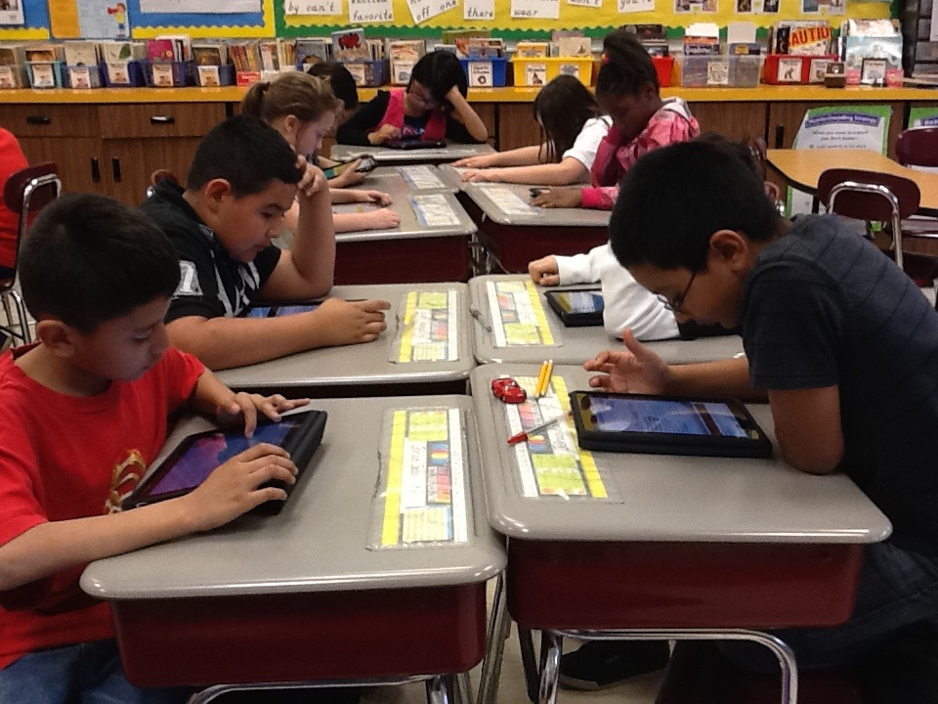
Annotation occurs with digital and print texts.

Slide 41
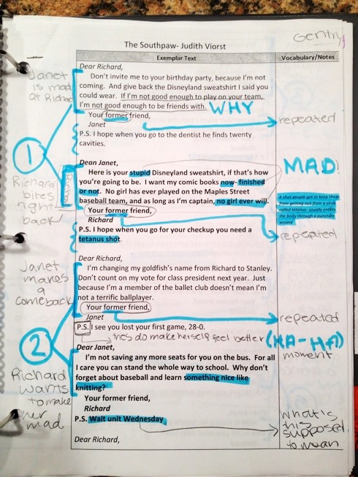
Student annotation in 6th grade
Student sample from Leigh McEwen, AEA 9, Iowa

Slide 42
Use a short passage
Re-reading
“Read with a pencil”
Text-dependent questions
Creating a Close Reading

Slide 43
Progression of Text-dependent Questions
Opinions/Arguments,
Intertextual Connections
Inferences
Author’s Craft and Purpose
Key Details
General Understandings
Vocab & Text Structure
What does the text mean?
Inferential
How does the text work?
Structural
What does the text say?
Literal

Slide 44
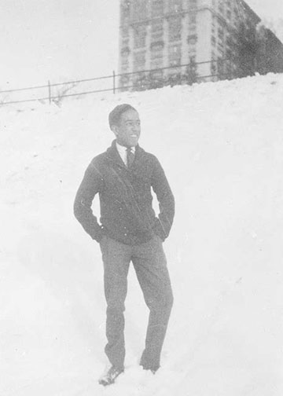
The Negro Speaks of Rivers
Langston Hughes (1921)
Langston Hughes high school yearbook photograph, 1920
Notes:
This morning we experienced a close reading with an informational text, specifically a speech. Now we’ll turn our attention to a literary text: a poem by Langston Hughes.
Facilitator: Background Knowledge (do not share with participants). Langston Hughes wrote this poem at the age of 17, during a long train ride to visit his father in Mexico. He had just graduated from high school, and was inspired as he crossed the Mississippi River in the late afternoon. The setting sun was turning the muddy brown water into a golden hue, and he wrote the phrase “the Negro speaks of rivers.” Within an hour, he had completed his poem. When the poem was first published several years later, he dedicated it to W.E.B. DuBois.

Slide 45
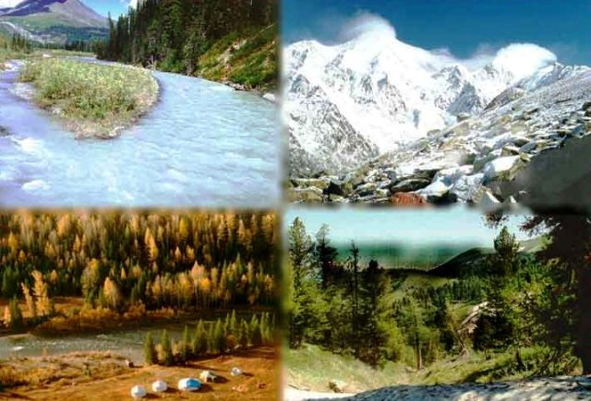
What does the text say? General Understanding
To what natural resource does the poet compare his people? What is your evidence?
Notes:
Facilitator: The poem compares the Negro people to rivers across the world.

Slide 46

What does the text say? Key Details
What rivers does he mention?
Notes:
Facilitator: this question doesn’t require a table discussion, as adults quickly arrive at this answer. You can use this as an example of a literal level question.

Slide 47

What does the text say? Key Details
Who is the “I” in the poem?
Notes:
Facilitator: this question doesn’t require a table discussion, as adults quickly arrive at this answer. You can use this as an example of a literal level question.

Slide 48

How does the text work? Vocabulary
What does water symbolize?
Notes:
Facilitator: Water is used to symbolize life. Fresh water symbolizes good health, while muddy water symbolizes death or bad times. Rivers are often used to symbolize change and the passage of time.

Slide 49

How does the text work? Vocabulary
Why is the word “The” significant in the title? Why does it hold more significance than “A”?
Notes:
Facilitator: The use of the word “THE” speaks of the whole of the people, not just an individual. Hughes is reminding us that African-Americans draw strength from their history and the span of their influence and presence across the world.

Slide 50

How does the text work? Vocabulary
What words does Hughes use to convey a sense of eternity?
Notes:
Facilitator: deep, continuous, mysterious.

Slide 51

How does the text work? Author’s craft
In lines 2 and 3, Hughes compares rivers to human veins. How are these two visually similar? How are they symbolically similar?
Notes:
Facilitator: Both rivers and veins have many branches that form a web or network, especially as they connect to other rivers or veins. Symbolically, both symbolize movement, and are necessary for life. If either a vein or a river stopped, death would soon occur. [PHOTO]: The Mississippi River delta, as imaged by Japan’s Advanced Land Observing Satellite.

Slide 52

Select some one in your group to read the speech aloud.
Add life! Let us feel it.
Use your voice and vary the speed.
Notes:
Facilitator: Remind participants that this isa poem, and as a spoken word piece it needs to be heard aloud. Ask group members to select a reader to read the speech aloud to the table.

Slide 53
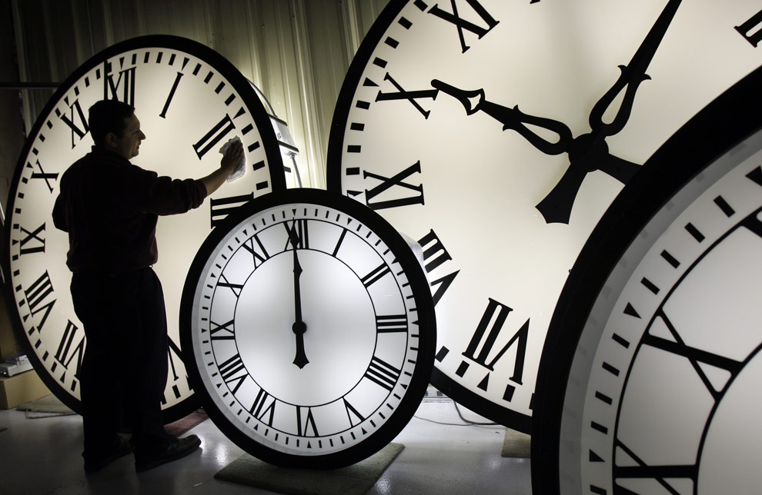
How does the text work? Structure
How much time passes in this poem? What words and phrases help you to determine this?
Notes:
Facilitator: the time period extends from approximately 3000 BC to the late 19th century.

Slide 54
How does the text work? Structure
How does Hughes use geography to convey a message? What is the significance of the order of the places he chose?
Notes:
Facilitator: The places Hughes mentions go from Mesopotamia, to the Congo, to Egypt, to New Orleans. He follows a pattern of natural migration (Mesopotamia and the Congo), to forced migration through enslavement (Egypt and New Orleans.)

Slide 55

What does the text mean? Inferences
Hughes describes the Mississippi River as a “muddy bosom turn all golden in the sunset.”
How does this line reveal the poet’s hopes for the future of his people?
Notes:
Facilitator: Hughes is contemplating the African-American’s experiences from enslavement (muddy) to hard-fought freedoms (golden). While he realizes there is still much to be done (this was written in 1921, decades before civil rights legislation), he is hopeful that there are some signs of improvement. However, the river remains muddy below its golden surface, suggesting there is still much to be done.

Slide 56

What does the text mean? Inferences
The poem traces a historical arc from freedom to enslavement, then freedom again. What is Hughes saying about his people throughout history?
Notes:
Facilitator: Hughes is tracing an arc of history to demonstrate their resilience, strength, and tenacity throughout the millennia. He is also tracing the rise and fall of other civilizations (the Egyptian empire, the Roman empire) to show that his people endure.

Slide 57

Writing From Sources
What are the underlying themes of this poem? After reading and discussing Langston Hughes’s poem “The Negro Speaks of Rivers” write an analytic essay that describes the themes of survival and strength. Support your discussion with evidence from the text. What is the poet’s message?
Constructed using Task Template 12: www.literacydesigncollaborative.org
Notes:
Facilitator: Participants do not need to write; this is an example of a writing task.

Slide 58

What does the text inspire you to do?
Presentation
Debate
Writing
Socratic seminar
Investigation and research
Test

Slide 59

A Close Reading of
“Salvador, Late or Early”
Cisneros, , S. (1991). Woman Hollering Creek.
Cisneros

Slide 60
What does the text inspire you to do?
Presentation
Debate
Writing
Socratic seminar
Investigation and research
Test

Slide 61
5 Access Points
Purpose and Modeling
Close and Scaffolded Reading
Collaborative Conversations
Wide, Independent Reading
Formative Assessments

Slide 62
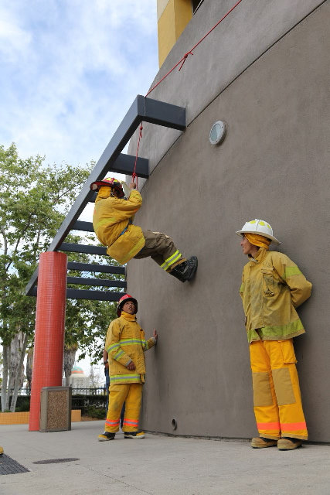
Close Reading demands collaborative conversations

Slide 63

Comprehension and Collaboration
1. Prepare for and participate in collaborations with diverse partners, building on each others’ ideas and expressing their own clearly and persuasively.

Slide 64
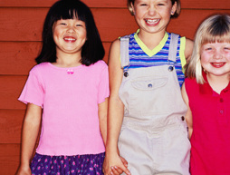

K-2 Features
Following the rules of discussion
Moving from participation to turn taking
Sustaining discussion through questioning
Adult support

Slide 65

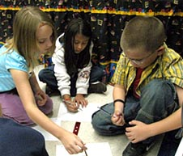
3-5 Features
Preparation for discussion
Yielding and gaining the floor
Posing and responding to questions
From explaining own ideas to explaining the ideas of others

Slide 66

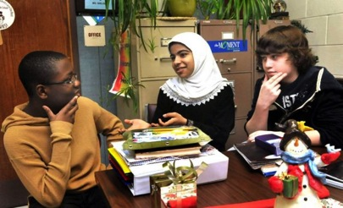
6-8 Features
Using evidence to probe and reflect
Collegial discussions include goals and deadlines
Questions connect ideas from several speakers
Acknowledge new information

Slide 67
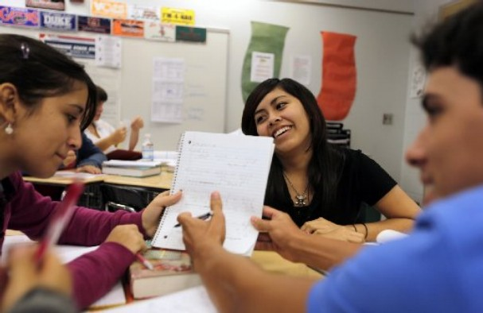

9-10 Features
Use prepared research in discussion
Voting, consensus, and decision making
Ensure hearing full range of opinions or options
Summarize and synthesize points of disagreement

Slide 68
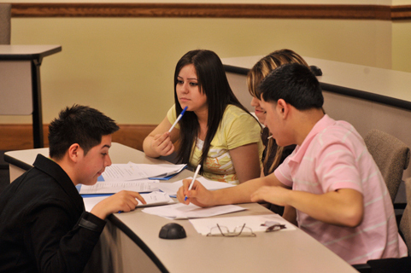

11-12 Features
Civil, democratic discussions
Questions probe reasoning and evidence
Resolving contradictions
Determine what additional info is needed

Slide 69

Which Is It?
Group Work
Productive
Group Work
Interaction
Academic language practice and development
Clarifying beliefs, values, or ideas
Goal is sharing
No accountability or group accountability
Consolidating understanding using argumentation
Goal is problem solving
Individual accountability

Slide 70
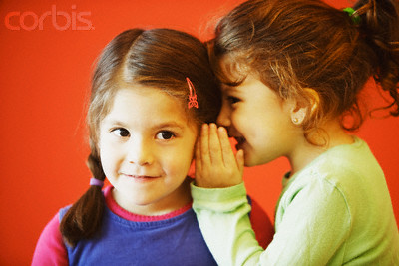
Group Work Examples
TTYPA Think-Pair-Square
Carousel Novel Ideas Only
Opinion Stations

Slide 71
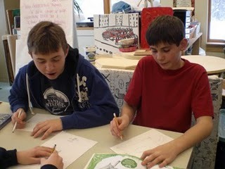
Productive Group Work Examples
Conversation Roundtable
Numbered Heads Together
Literature Circles
Reciprocal Teaching
Jigsaw
Collaborative Poster

Slide 72
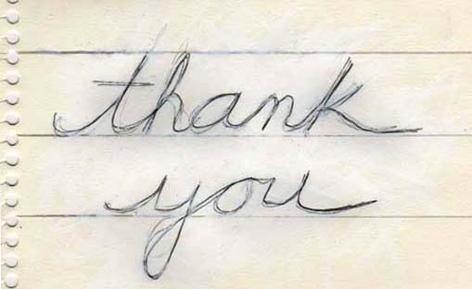
http://www.fisherandfrey.com

