Slide 1
Doug Fisher
www.fisherandfrey.com
Visible Learning for Literacy

Slide 2
Every student deserves a great teacher, not by chance, but by design.

Slide 4
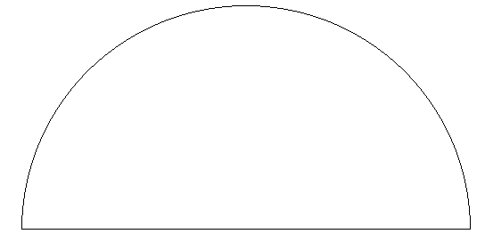
0.4
0.5
0.6
0.3
0.7
0.2
Medium
0.8
0.1
High
0.9
Low
0.0
1.0
Teacher effects
1.1
-0.1
Developmental effects
Negative
1.2
-0.2
Reverse effects
Zone of desired effects
Hattie, J. (2009). Visible learning: A synthesis of over 800 meta-analyses related to achievement.
New York: Routledge.
Notes:
Standard error =
Rank: /136
Number of meta-analyses:
Number of studies:
Number of participants:

Slide 5
0.4
0.5
0.6
0.3
0.7
0.2
Medium
0.8
0.1
High
0.9
Low
0.0
1.0
Teacher effects
1.1
-0.1
Developmental effects
Negative
1.2
-0.2
Reverse effects
Zone of desired effects
Hattie, J. (2009). Visible learning: A synthesis of over 800 meta-analyses related to achievement.
New York: Routledge.
Notes:
Standard error = n/a
Rank: 136/136
Number of meta-analyses: 7
Number of studies: 207
Number of participants: 13,938

Slide 6
0.4
0.5
0.6
0.3
0.7
0.2
Medium
0.8
0.1
High
0.9
Low
0.0
1.0
Teacher effects
1.1
-0.1
Developmental effects
Negative
1.2
-0.2
Reverse effects
Zone of desired effects
Hattie, J. (2009). Visible learning: A synthesis of over 800 meta-analyses related to achievement.
New York: Routledge.
Notes:
Standard error = 0.016 (low)
Rank: 125/136
Number of meta-analyses: 2
Number of studies: 92
Number of participants: n/a

Slide 7
0.4
0.5
0.6
0.3
0.7
0.2
Medium
0.8
0.1
High
0.9
Low
0.0
1.0
Teacher effects
1.1
-0.1
Developmental effects
Negative
1.2
-0.2
Reverse effects
Zone of desired effects
Hattie, J. (2009). Visible learning: A synthesis of over 800 meta-analyses related to achievement.
New York: Routledge.
Notes:
Std. error = 0.027 (low)
Rank: 88/136
Number of meta-analyses: 5
Number of studies: 161
Number of effects: 295
Number of participants: 105,282

Slide 8
0.4
0.5
0.6
0.3
0.7
0.2
Medium
0.8
0.1
High
0.9
Low
0.0
1.0
Teacher effects
1.1
-0.1
Developmental effects
Negative
1.2
-0.2
Reverse effects
Zone of desired effects
Hattie, J. (2009). Visible learning: A synthesis of over 800 meta-analyses related to achievement.
New York: Routledge.
Notes:
Standard error = 0.081 (high)
Rank: 58/136
Number of meta-analyses: 8
Number of studies: 674
Number of participants: n/a

Slide 9
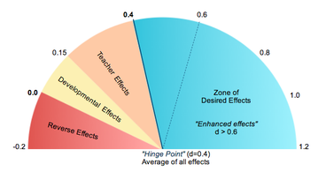
This is the hinge point –
a year’s worth of growth for a year in school.

Slide 10
0.4
0.5
0.6
0.3
0.7
0.2
Medium
0.8
0.1
High
0.9
Low
0.0
1.0
Teacher effects
1.1
-0.1
Developmental effects
Negative
1.2
-0.2
Reverse effects
Zone of desired effects
Mobility: d = -.34
Hattie, J. (2009). Visible learning: A synthesis of over 800 meta-analyses related to achievement.
New York: Routledge.
Notes:
Std. error = 0.027 (low)
Rank: 88/136
Number of meta-analyses: 5
Number of studies: 161
Number of effects: 295
Number of participants: 105,282

Slide 11
0.4
0.5
0.6
0.3
0.7
0.2
Medium
0.8
0.1
High
0.9
Low
0.0
1.0
Teacher effects
1.1
-0.1
Developmental effects
Negative
1.2
-0.2
Reverse effects
Zone of desired effects
Retention: d = - 0.13
Hattie, J. (2009). Visible learning: A synthesis of over 800 meta-analyses related to achievement.
New York: Routledge.
Notes:
Standard error = n/a
Rank: 136/136
Number of meta-analyses: 7
Number of studies: 207
Number of participants: 13,938

Slide 12
0.4
0.5
0.6
0.3
0.7
0.2
Medium
0.8
0.1
High
0.9
Low
0.0
1.0
Teacher effects
1.1
-0.1
Developmental effects
Negative
1.2
-0.2
Reverse effects
Zone of desired effects
Ability Grouping/Tracking: d = 0.12
Hattie, J. (2009). Visible learning: A synthesis of over 800 meta-analyses related to achievement.
New York: Routledge.
Notes:
Standard error = 0.045
Rank: 112/136
Number of meta-analyses: 14
Number of studies: 500
Number of participants: 1,369

Slide 13
0.4
0.5
0.6
0.3
0.7
0.2
Medium
0.8
0.1
High
0.9
Low
0.0
1.0
Teacher effects
1.1
-0.1
Developmental effects
Negative
1.2
-0.2
Reverse effects
Zone of desired effects
Teaching test taking: d = .22
Hattie, J. (2009). Visible learning: A synthesis of over 800 meta-analyses related to achievement.
New York: Routledge.
Notes:
Std. error = 0.027 (low)
Rank: 88/136
Number of meta-analyses: 5
Number of studies: 161
Number of effects: 295
Number of participants: 105,282

Slide 14
0.4
0.5
0.6
0.3
0.7
0.2
Medium
0.8
0.1
High
0.9
Low
0.0
1.0
Teacher effects
1.1
-0.1
Developmental effects
Negative
1.2
-0.2
Reverse effects
Zone of desired effects
Small group learning: d = 0.49
Hattie, J. (2009). Visible learning: A synthesis of over 800 meta-analyses related to achievement.
New York: Routledge.
Notes:
Standard error = n/a
Rank: 48/136
Number of meta-analyses: 2
Number of studies: 78
Number of participants: 3,472

Slide 15
0.4
0.5
0.6
0.3
0.7
0.2
Medium
0.8
0.1
High
0.9
Low
0.0
1.0
Teacher effects
1.1
-0.1
Developmental effects
Negative
1.2
-0.2
Reverse effects
Zone of desired effects
Study Skills: d = 0.59
Hattie, J. (2009). Visible learning: A synthesis of over 800 meta-analyses related to achievement.
New York: Routledge.
Notes:
Standard error = n/a
Rank: 48/136
Number of meta-analyses: 2
Number of studies: 78
Number of participants: 3,472

Slide 16
0.4
0.5
0.6
0.3
0.7
0.2
Medium
0.8
0.1
High
0.9
Low
0.0
1.0
Teacher effects
1.1
-0.1
Developmental effects
Negative
1.2
-0.2
Reverse effects
Zone of desired effects
Repeated Reading: d = 0.67
Hattie, J. (2009). Visible learning: A synthesis of over 800 meta-analyses related to achievement.
New York: Routledge.
Notes:
Standard error =
Rank:
Number of meta-analyses:
Number of studies:
Number of participants: 5,028

Slide 17
0.4
0.5
0.6
0.3
0.7
0.2
Medium
0.8
0.1
High
0.9
Low
0.0
1.0
Teacher effects
1.1
-0.1
Developmental effects
Negative
1.2
-0.2
Reverse effects
Zone of desired effects
Classroom Discussion: d = 0.82
Hattie, J. (2009). Visible learning: A synthesis of over 800 meta-analyses related to achievement.
New York: Routledge.
Notes:
Standard error =
Rank:
Number of meta-analyses:
Number of studies:
Number of participants: 677

Slide 18
0.4
0.5
0.6
0.3
0.7
0.2
Medium
0.8
0.1
High
0.9
Low
0.0
1.0
Teacher effects
1.1
-0.1
Developmental effects
Negative
1.2
-0.2
Reverse effects
Zone of desired effects
Collective Teacher Efficacy: d = 1.57
Hattie, J. (2009). Visible learning: A synthesis of over 800 meta-analyses related to achievement.
New York: Routledge.
Notes:
Standard error =
Rank:
Number of meta-analyses:
Number of studies:
Number of participants: 677

Slide 19
Teachers know what students need to learn
Teachers communicate learning intentions to students
Teachers and students understand success criteria

Slide 20
0.4
0.5
0.6
0.3
0.7
0.2
Medium
0.8
0.1
High
0.9
Low
0.0
1.0
Teacher effects
1.1
-0.1
Developmental effects
Negative
1.2
-0.2
Reverse effects
Zone of desired effects
Teacher Clarity: d = 0.75
Hattie, J. (2009). Visible learning: A synthesis of over 800 meta-analyses related to achievement.
New York: Routledge.
Notes:
Standard error = 0.079 (Medium)
Rank: 3/136
Number of meta-analyses: 2
Number of studies: 30
Number of participants: 3835

Slide 21
The established purpose
focuses on student learning, rather than an activity, assignment, or task.

Slide 22
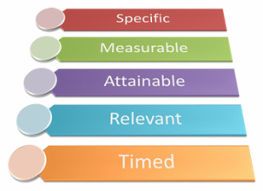

Slide 24
Three Questions
What am I learning today?
Why am I learning this?
How will I know that I have learned it?
p. 27
Notes:
How will I know that I have learned it? Last time talked about the other two questions.
What works when?

Slide 25
Teachers know what students need to learn
Teachers communicate learning intentions to students
Teachers and students understand success criteria

Slide 26
Sara explained the writing rubric, used reasoning to argue her status, and conveyed a set of experiences about writers at each level.

Slide 27
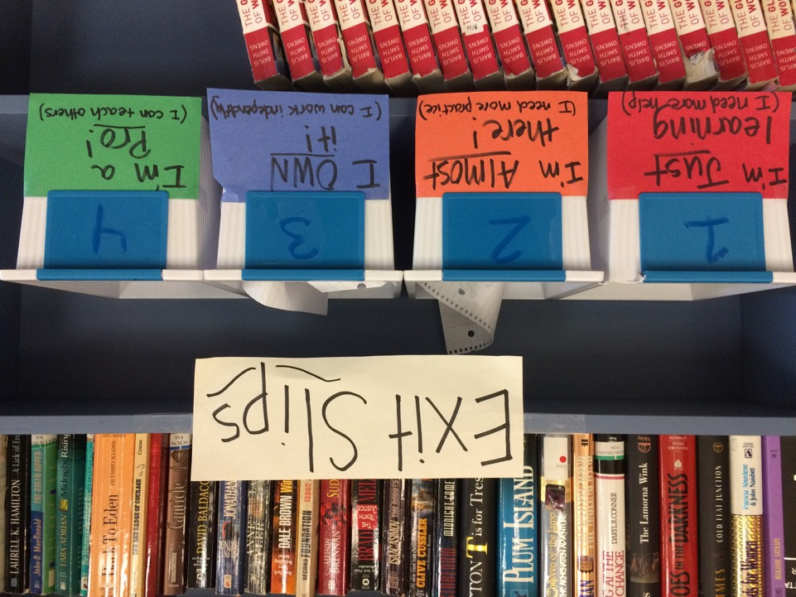
p. 31

Slide 28
Transfer
Deep
Surface
p. 20
Notes:
Mistake- using strategies to get to transfer surface and deep. All strategies work all the time.
I concept- 1 skill
1 strategy only. Surface knowledge learn with others.
Surface goes to DEEP connect schema. If teacher does it then not deep learning.

Slide 29
Surface
Skill and Concept Development
p. 20

Slide 30
Deep
Connections, relationships and schema to organize skills and concepts
Surface
Skill and Concept Development
p. 20
Notes:
If teacher does it not deep learning. Product may not be the result of deep learning. Easier to measure, occurs faster, takes longer.
Transfer takes years to access…more research on surface.
CST- surface assessment
Read across multiple docs and respond to text- deep learning
Transfer knowledge is being assessed.
What works when?
Self directed reading- jigsaw
Video- Board speaks on math: demonstrate surface

Slide 31
Transfer
Self-regulation to continue learning skills and content, applying knowledge to novel situations
Deep
Connections, relationships and schema to organize skills and concepts
Surface
Skill and Concept Development
p. 20

Slide 32
What Works
When
Notes:
Surface learning is important.

Slide 33
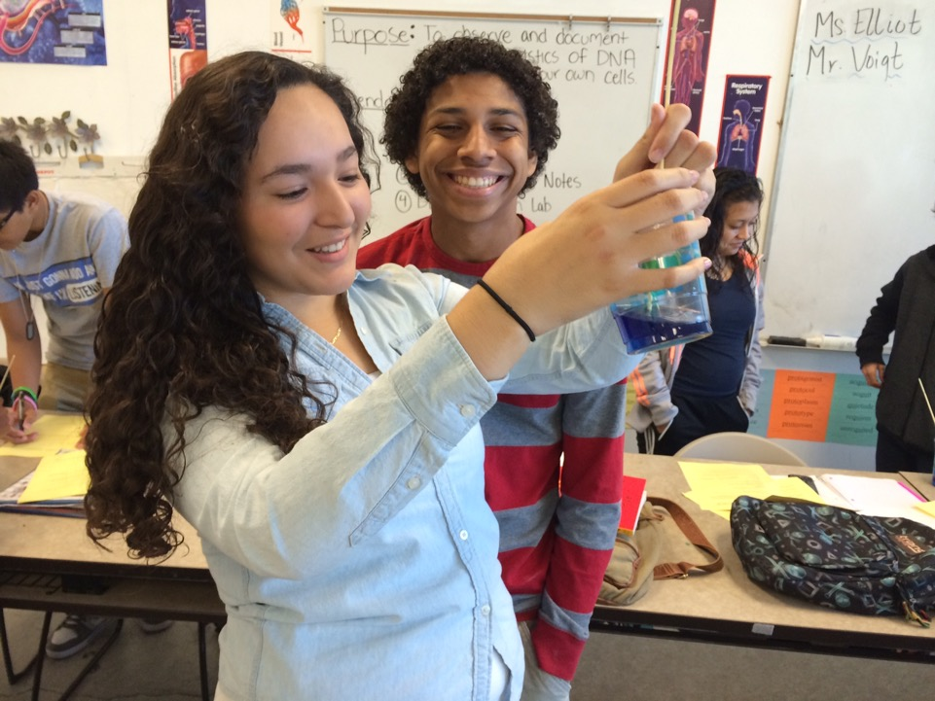
Surface Learning is IMPORTANT
Notes:
Cannot go deep without surface.

Slide 34
Ways to Facilitate Surface Learning
Leveraging prior knowledge (d=0.65)
Vocabulary techniques (sorts, word cards, etc.) (d=0.67)
Reading Comprehension Instruction (d=0.60)
Wide reading on the topic under study (d=0.42)
Summarizing (d=0.63)
Notes:
In book---Grade 2 Video Lesson strong and surface level
CELDT Level 2- Thanksgiving Video
Identify Surface Level Learning- Teacher modeling what she wants them to write, vocabulary provided, sentence frames, activating prior knowledge, Chart what will you be doing during Thanksgiving Break and then what did they do…verb tense.
Move to deeper- use conversational lines see drop register when gradual release.
Over generalization of verb- pay attention to Do with coaching
Student/Teacher Talk- 50% in real time
Re-establishes learning target- 3 times
Learning past tense or else kids think learning about Thanksgiving
Risk locked into Thanksgiving and not verb. If you leave them there get stuck so needs to practice on their own to deep.
Kids need to practice- volume of reading

Slide 35
Reading Volume Still Matters

Slide 36
STUDENT A
20 MINUTES PER DAY
1,800,000 WORDS PER YEAR
SCORES IN THE 90TH PERCENTILE ON STANDARDIZED TESTS

Slide 37
STUDENT B
5 MINUTES PER DAY
282,000 WORDS PER YEAR
SCORES IN THE 50TH PERCENTILE ON STANDARDIZED TESTS
Notes:
If read enough outside of school. Less read – less do well in school.
What have you done to ressusitate reading at home? VOLUME MATTERS
What ideas can you steal?

Slide 38
STUDENT C
1 MINUTE PER DAY
8,000 WORDS PER YEAR
SCORES IN THE 10TH PERCENTILE ON STANDARDIZED TESTS
Notes:
Keep focus on simple way to keep kids reading outside of school. Builds vocabulary and knowledge

Slide 39
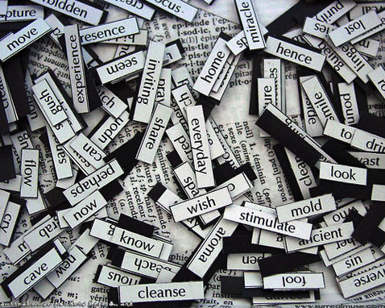
Vocabulary Instruction
Notes:
Surface level approach-

Slide 40
Types of Vocabulary
Tier 1/General
Commonplace; learned from interactions with texts and people
Tier 2/Specialized/General Academic
Change meaning with context (“polysemic”)
Tier 3/Technical/Domain-specific
Specific to the discipline
A starting point for selecting vocabulary
Notes:
Tier 1, 2, 3 changed to General Academic and Domain Specific
With CCSS
Under teach on Change meaning with context e.g. run change definitition
P. 51 How to choose words to be taught?
Explicitly teach to gain understanding
If book/video/discussion/writing needed then must be taught.

Slide 41
Questions for Selecting Vocabulary
Representative
Repeatability
Transportable
Contextual Analysis
Structural Analysis
Cognitive Load
Is it critical to understanding?
Will it be used again?
Is it needed for discussions or writing?
Can they use context to figure it out?
Can they use structure?
Have I exceeded the number they can learn?
p. 51
Notes:
Use the questions on slide
Teach them how to figure out the meaning- word part, context clues, WORD SOLVING
If text has 45 new words- too many cognitively
Words strips in envelope and place order then retell person when it appeared.
Helps kids process the vocabulary.
Show video with vocabulary or writing tasks.
Can cause passive behavior…Must be doing something
Vocabulary stepping stones…
Word Cards (1956) Frair
4 boxes- write word, define, draw picture, oppositive
Need time to process definition
Test on knowledge and tear out when they demonstrate mastery
Must have 5 signatures on the card
Surface to deep - making card surface – tell meaning is deep
Self-Awareness Chart in Physics
Student responsible for collecting words that are not known.
Chart students learn to add words they need to learn to their journals.
Not deep until they apply and practice using these charts

Slide 42
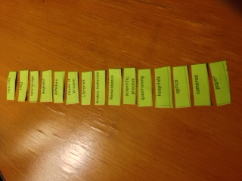
Foster Collaboration through Vocabulary Steppingstones
Pairs arrange vocabulary in order as it is used in a film, demonstration, or lecture.
Retell using vocabulary to prompt recall of content.
Steppingstones are then used for written summary.

Slide 43
Sara’s Vocabulary Card in World History

Slide 44
Tino’s Vocabulary Self-Awareness Chart in Physics

Slide 45
Alphabet Vocabulary Chart
A-B | C-D | E-F | G-H
I-J | K-L | M-N | O-P
Q-R | S-T | U-V-W | X-Y-Z

Slide 46
Alphabet Vocabulary Chart
A-B | C-D crater | E-F | G-H
I-J | K-L lava | M-N magma | O-P
Q-R | S-T | U-V-W volcano | X-Y-Z
Pre-assessment of prior vocabulary knowledge
Notes:
Words related to volcano. All knew lava.

Slide 47
Alphabet Vocabulary Chart
A-B ash | C-D crater cinder cone | E-F flow | G-H
I-J | K-L lava | M-N magma magnitude | O-P
Q-R Rim of Fire | S-T shield volcano tremor | U-V-W volcano vent volcanologist | X-Y-Z
Mid-unit assessment

Slide 48
Alphabet Vocabulary Chart
A-B ash active balsat | C-D crater cinder cone caldera | E-F flow eruption extrusion | G-H geothermal harmonic tremor
I-J intrusion | K-L lava lahar | M-N magma magnitude mantle | O-P obsidian pahoehoe pillow lava
Q-R Rim of Fire | S-T shield volcano tremor | U-V-W volcano vent volcanologist | X-Y-Z xenoliths
End-of-unit review

Slide 49
Surface
Skill and Concept Development
Notes:
Video of John- History Teacher
Model think aloud- okay to talk -Surface teacher modeling
What is your status of your modeling?
15 mins. Personal Learning on your own.
Pg. 59 Notetaking
Pg. 61 Rehearsal and Memoriazation
Pg. 66 Feedback

Slide 50
Notes:
Video on speaks math: Surface
Direct instruction is not telling

Slide 51
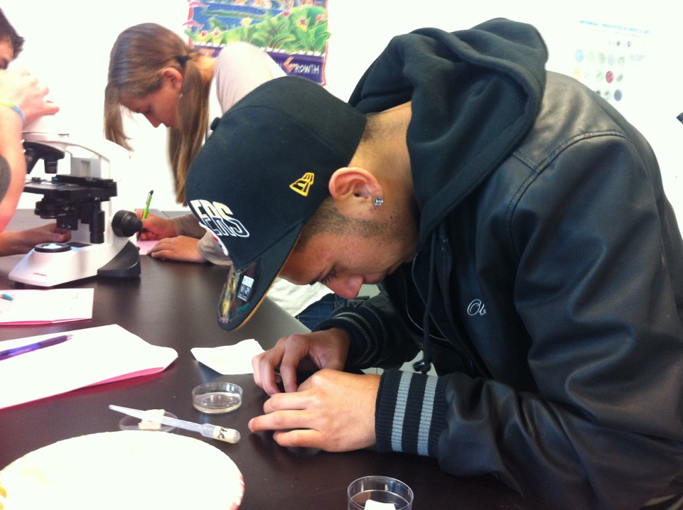
Deep Learning is Also Important

Slide 52
Ways to Facilitate Deep Learning
Concept mapping (d=0.60)
Class Discussion (d=0.82)
Questioning (d=0.48)
Metacognitive strategies (d=0.69)
Reciprocal teaching (d=0.74)

Slide 53
Deep learning approaches don’t work any better at developing surface learning than surface learning strategies work to develop deep understanding.

Slide 54
p. 82

Slide 55
Discussion Roundtable
1 My notes | What ___ said 2
3 What ___ said | 4 What ___ said
5
Independent
Summary
Deep Acquisition and Deep Consolidation
p. 76-77
Notes:
Deep learning- Blue Graphic Organizer:
Fostering self-regulation and need to plan, organize, elaborate and reflect.
#3: Add to Mai Yia- At the end, writing student consolidate conceptual understanding by writing, values, beliefs, get what we ask for? If you do not ask for it, will not get it. Mary- Able to identify his capabilities. Knew what he could do and seek out what he needed to do. Self talk and regulation.

Slide 56
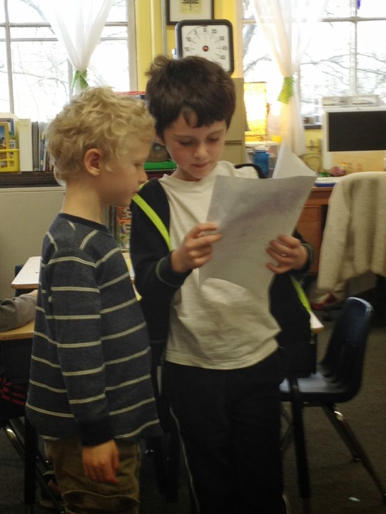
Graphic organizers and concept maps are an intermediate step to something else —discussion or writing.
Notes:
Video- Transplant Grade 1
Hand signals
Video- Secondary Surface to Deep GRADE 11
Early attempt of content teacher with complex text
Pushing toward more complex

Slide 57
Text Rendering: National School of ?
Go around and say a sentence
Round 2- only say phrases
Round 3- say one word
Group Discussion- what words emerge after discussion
What do you think was the most important part of the text?
Page 73:
Have to report to group.
Listen to others- your thinking evolves and phrase changes.
Word may not have come from original thinking
No right answer
Scribe write down nouns and write something
Write down who said it for accountability
Notes:
NEW SLIDE: PURPOSE: TO USE A COLLABORATIVE PROCESS TO ENGAGE IN AN INSPECTION OF A TEXT.
Q AND A

Slide 58
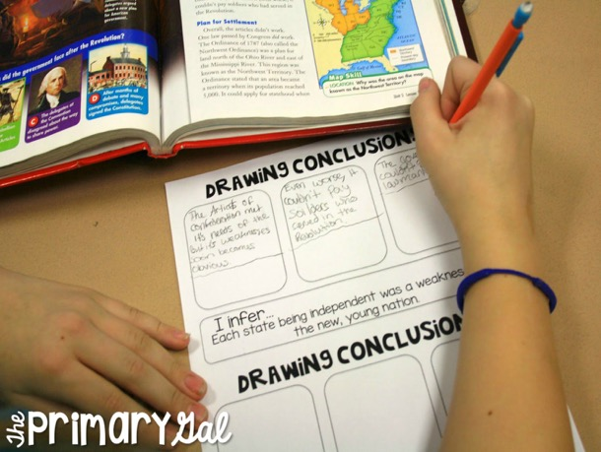
Concept maps foster connections, but only when students create them.
Transformation of knowledge, not replication.
pp. 79-82

Slide 59
Deep
Connections, relationships and schema to organize skills and concepts
Surface
Skill and Concept Development

Slide 60
Transfer
Notes:
From deep to have ownership
Understanding by Design- transfer

Slide 61
“The ability to transfer is arguably the long-term aim of all education. You truly understand and excel when you can take what you have learned in one way or context and use it in another, on your own.”
McTighe & Wiggins, 2011
Notes:
Stamina, fluency etc. leads to transfer

Slide 62
Ways to Facilitate Transfer
Reading across documents to conceptually organize (d=0.85)
Formal discussion, including debates and Socratic seminars (d=0.82)
Problem-solving teaching (d=0.61)
Extended writing (d=0.43)
Peer tutoring (d=.55)
Notes:
SBAC PT is about transfer
Formal discussion- transfer but not able to plan ahead
Problem solving teaching- work through
Writing- requires transfer long pieces of writing
Longer essays example
Peer Tutoring- teach someone else something
Hard to accomplish

Slide 63
The right approach, at the right time, for the right type of learning.
Notes:
Take our students need surface and what works, what need for deep, what need for transfer

Slide 64
The Case for Struggle
Transfer comes from struggle
Is there an anti-struggle mentality?
We will not get to transfer without struggle cognitively
Where there is struggle, there is no strength?
Without strong teacher/student relationship- no struggle due to lack of trust
Video on scratcher
Give it a go- Video
Believe in yourself and others- comfortable to struggle
Trusting- growth producing relationships
Name Game: Story behind the name
Significance of name
Clarity- with content
More Complex= Less Complex
Easy—Hard

Slide 65
www.fisherandfrey.com

Slide 66
Not goal to live in high/high
Need to be at the bottom
Productive Failure- from Math
Kapur- Productive Failure
Examine google searches for Productive Failure
The more you struggle the more you will master the information
What if we designed learning for failure?
How do you respond to fail? Errors are celebrated..opportunities to learn
What if we plan for some failure so kids can learn from it.
How does it work with Literacy?
Keep CALM and Struggle on
What do you want to take back?
Teacher clarity, surface learning, struggle
Identify- What do you want my school to do?

