Slide 1


How to Take
CORNELL WAY Schoolwide

Slide 2
AVID’s mission is to close the achievement gap by preparing all students for college readiness and success in a global society.
2
Notes:
TALKING POINTS: (approved C&L (Mullen, Lozano, Friou) 09.2014)
The AVID College Readiness System, available for elementary, secondary, and higher education, is a schoolwide transformational effort focused on instruction, systems, leadership, and culture, and is designed to increase the number of students who enroll and succeed in higher education and in their lives beyond high school.
The AVID College Readiness System is a catalyst for developing a school culture that closes the expectation and opportunity gaps many students face, and prepares all students for success in a global society.
AVID Elementary is a foundational component for elementary schools, designed as an embedded, sequential academic skills resource. It is intended for non-elective, multi-subject, multi-ability level classrooms.
-Through the use of WICOR and an explicit focus on high expectations, rigor, and developing a college readiness culture, educator behaviors and mindsets will prepare all students to be on a college readiness path.
AVID Elementary’s core focus is on grades 3 through 5 or 6 (depending on configuration of the school) with on-ramps provided for K-2 teachers.
At the high school and middle level, AVID impacts an entire school system by transforming the instruction, systems, leadership, and culture of a school. At the core of AVID at the high school and middle level is the AVID Elective class where students are enrolled in a school’s most rigorous classes, such as Advanced Placement® (AP) and receive support in the AVID Elective class—taught within the school day by a trained AVID teacher. The goal of AVID at the secondary level is to ensure college readiness for all AVID Elective students and improved academic performance for all students based on increased opportunities.
AVID for Higher Education partners with institutions of higher education by providing AVID professional learning and support systems that result in increased student learning, persistence, and graduation.
Each component in the AVID College Readiness System has continuity to the next through the basic tenets of AVID that include Essentials, WICOR, and a site team.

Slide 3
Norms
Ask questions
Engage fully
Integrate new information
Open your mind to diverse views
Utilize what you learn
Used with permission of Learning Forward, www.learningforward.org. All rights reserved.

Slide 4
Learning Objectives
Participants will be able to….
Understand the difference between Cornell notes and The Cornell Way
Understand the importance of steps 8-10 in the CORNELL WAY
Examine barriers and brainstorm solutions for extending the CORNELL WAY process schoolwide

Slide 5
Agenda
AVID Essentials
Review the Cornell Note-Taking System
Model steps 3-10 of CORNELL WAY
Use collaborative activities to facilitate discussion
Create SMART goals
Establish/Update your Individual Action Plan
Reflect and Connect

Slide 6
Essential Question
CORNELL NOTES | TOPIC/OBJECTIVE: | NAME:
 |  | CLASS/PERIOD:
 |  | DATE:
ESSENTIAL QUESTION: How will you model the CORNELL WAY on your campus and support the consistent use of this process schoolwide?
HO: Cornell Notes pp. 26-31

Slide 7
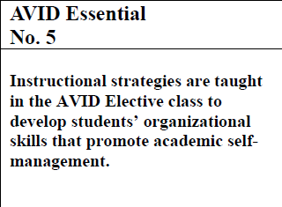
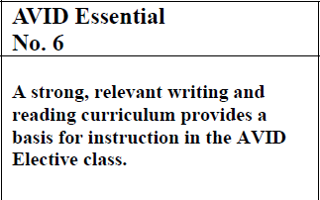
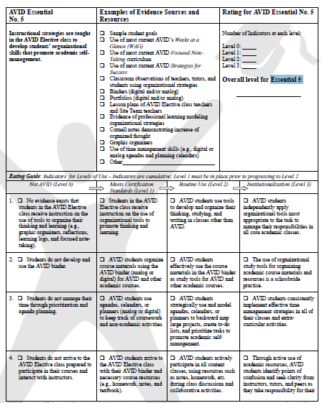
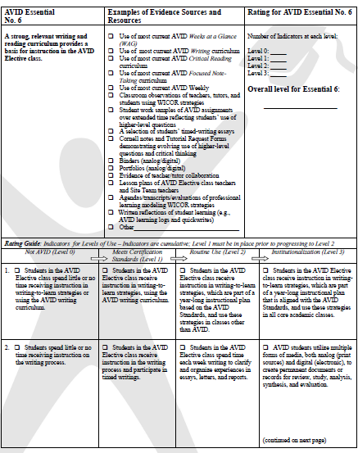
Essentials Addressed
HO: pp. 1-5

Slide 8
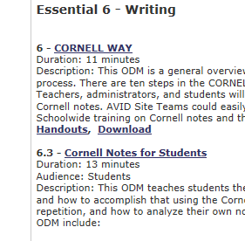
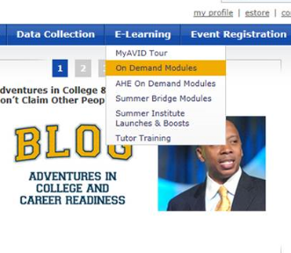
Focused Note-Taking Resources

Slide 9
Focused Note-Taking
CORNELL NOTE-TAKING SYSTEM
NOTE-TAKING
NOTE-MAKING
NOTE-INTERACTING
NOTE-REFLECTING
STEP 1
Create Format
STEP 3
Review & Revise Notes
STEP 6
Link Learning to Create a Synthesized Summary
STEP 8
Written Feedback
STEP 2
Organize Notes
STEP 4
Note Key Ideas to Create Questions
STEP 7
Use Completed Cornell Notes as a Learning Tool
STEP 9
Address Written Feedback
STEP 5
Exchange Ideas by Collaboration
STEP 10
Your Reflection
HO: pp. 6-9

Slide 10
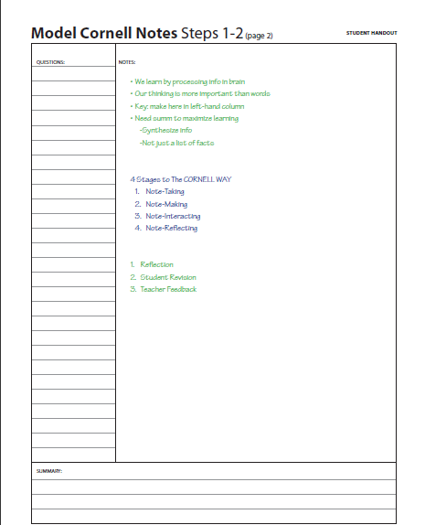
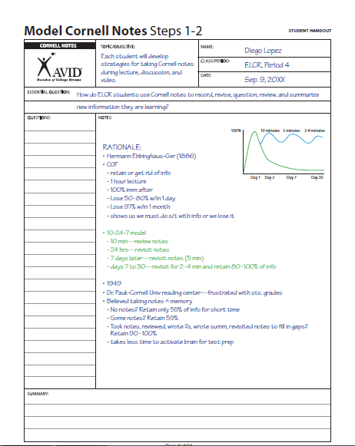
Think About It!
Do these notes exemplify the CORNELL WAY?
HO: pp. 1-2

Slide 11
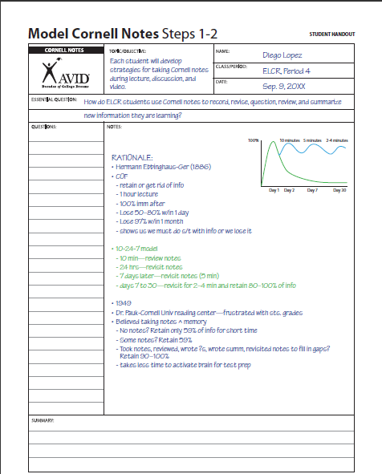

Steps 1-2
C-Create your format and heading
O-Organize your notes on the right hand side of your paper while taking notes during lecture

Slide 12
Steps 3-5
R-Review and Revise your notes
N-Note Key Ideas (create questions on the left side of your paper that connect to highlighted main ideas on the right)
E-Exchange ideas and help each other fill in gaps

Slide 13
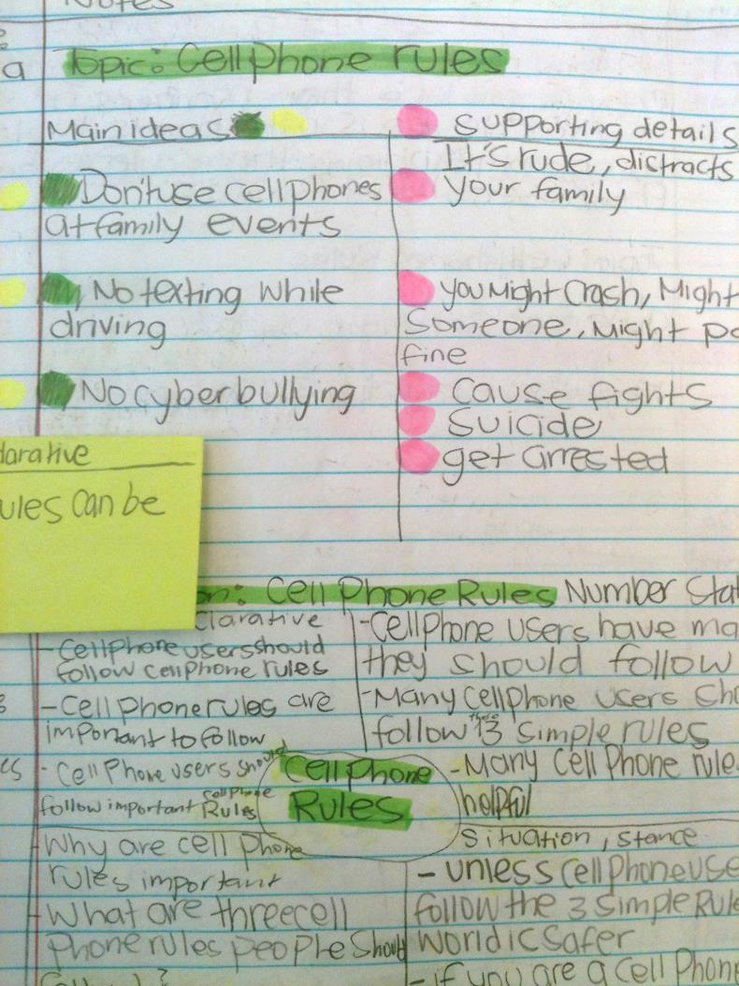
Talk About It!
Do your students revisit notes and highlight?
What do you encourage them to highlight?

Slide 14
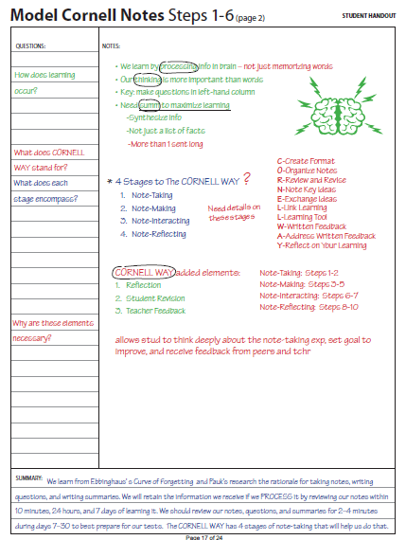
Steps 6-7
L-Link Learning by summarizing your notes at the bottom of your paper
L-Use your notes as a Learning Tool by reviewing what you learned
HO: p. 12

Slide 15
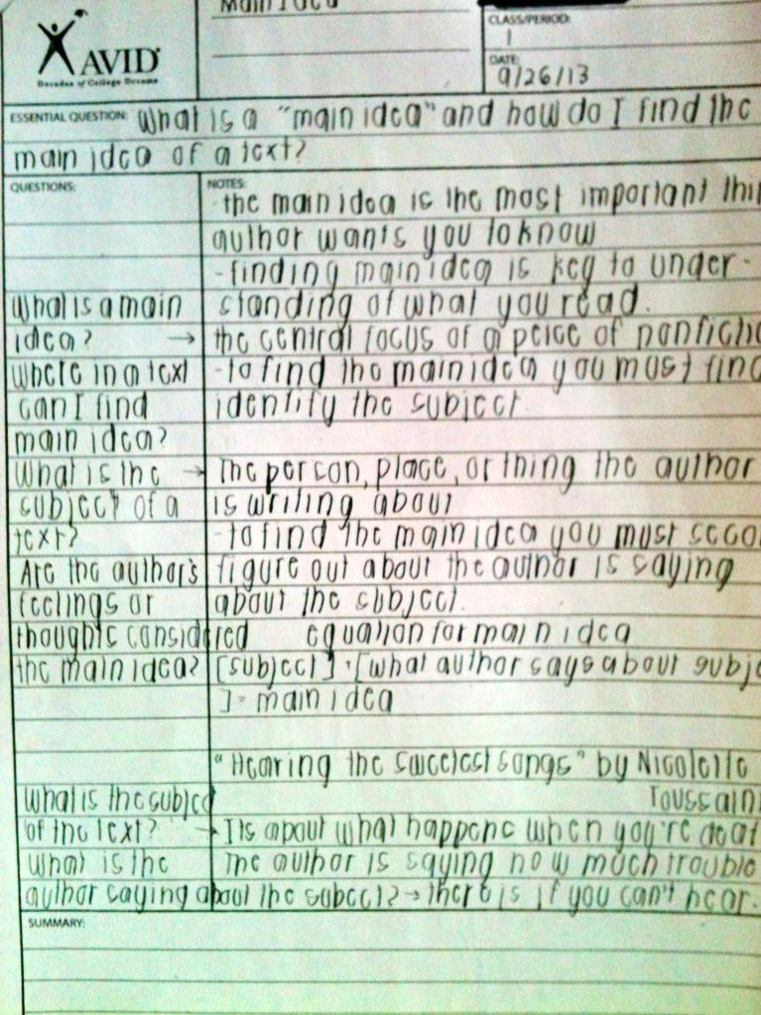
Talk About It!
How can we reinforce the importance of summarizing?

Slide 16
Focused Note-Taking
CORNELL NOTE-TAKING SYSTEM
NOTE-TAKING
NOTE-MAKING
NOTE-INTERACTING
NOTE-REFLECTING
STEP 8
Written Feedback
How can you incorporate Steps 8, 9 and 10 into your class?
STEP 9
Address Written Feedback
STEP 10
Your Reflection

Slide 17
Step 8: Written Feedback
Using the resources provided, give written feedback on each other’s notes
HO: p. 13

Slide 18

Step 9: Address Feedback
Review your partner’s feedback.
How did your feedback differ?
Address the feedback by creating a SMART goal on how to improve your note-taking skills.
How does this kind of feedback affect our students’ ability to improve their note-taking practice?
How would you support peer to peer evaluation?
HO: p. 14

Slide 19

Write a reflection on the entire note-taking process from today.
How you can actualize this schoolwide?

Slide 20
Carousel Brainstorming
What barriers would teachers have in implementing the Cornell Note-taking system in their class?
What struggles would students have in developing effective note-taking skills (i.e. Cornell Notes)?
What obstacles would hinder the support of Cornell note-taking as a schoolwide strategy in ALL classes?

Slide 21
Essential Question Revisted
CORNELL NOTES | TOPIC/OBJECTIVE: | NAME:
 |  | CLASS/PERIOD:
 |  | DATE:
ESSENTIAL QUESTION: How will you model the CORNELL WAY on your campus and support the consistent use of this process schoolwide?
HO: pp. 15-24

Slide 22
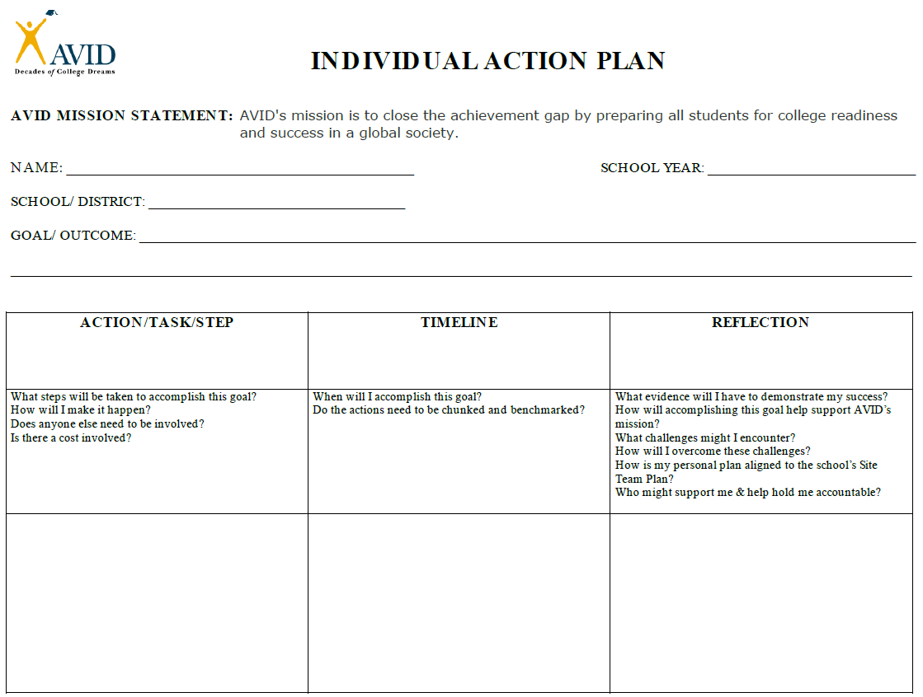
Individual Action Plan
HO: p. 25

Slide 23
Reflection: 3, 2, 1
3
Important ideas to take away from today's workshop and share at your site
2
Ways in which your ideas were validated
1
Action step from your individual action plan that you will immediately apply to your practice

Slide 24
Contact Information

